Slide 1
Patient’s Condition Classification Using Drug Reviews
Faysal Miah ID: 1721758042
Miraz Ibn Azad ID: 1721910042

Slide 2
Problem Statement and Workflow
Doctors and Specialists using the results of tests labs of patients to classify their needed care, which is time-consuming. The purpose of this project is to utilize Natural Language Processing(NLP) and Machine Learning in classifying patient to reduce the efforts and time expanded by the doctors and evaluate the type of patient at an early stage.
Dataset - https://archive.ics.uci.edu/ml/datasets/Drug+Review+Dataset+%28Drugs.com%29
Lemmatization
Model Building
Evaluation

Slide 3
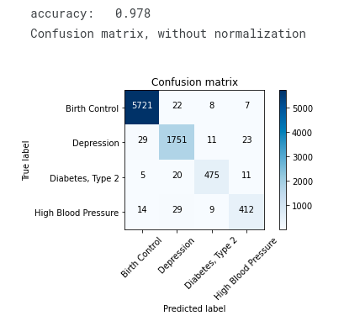
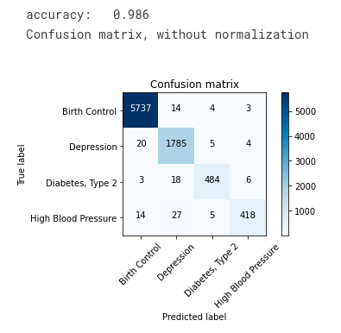
Result
Bag of Word TFIDF : Trigrams

Slide 4
